Slide 1
Crafting & Compelling Website Analysis, Audit and Recommendations
Naveen Ramesh
BADM-WD-T-B5

Slide 2
Problem Objective
Digital Marketing Fundamentals: Learn The Key Principles Of Digital Marketing, Focusing On Website And Landing Page Design.
Design And Build Web Presence: Grasp The Inner Workings Of Websites, Including Critical Elements And Design Principles.
Hands-on Creation: Create Landing Pages From Scratch Using Best Practices In Digital Marketing And Website Design

Slide 3

About HCL Tech
I have chosen HCL company for my analysis https://www.hcltech.com/
HCL Tech is a global leader in IT services and consulting, offering cutting-edge solutions in cloud computing, digital transformation, engineering, cybersecurity, and more. With a strong presence across 50+ countries, it drives innovation and sustainability for enterprises worldwide.
CEO: C Vijayakumar
Founder: Shiv Nadar
Headquarters: Noida
Founded: 12 November 1991

Slide 4

Products/Services of HCL Tech
HCL Tech is the services based company.
Some of the services offered by the HCL tech includes; Digital Transformation, Engineering & R&D, Cybersecurity, App Development and IT Infrastructure.
Engineering and R&D Services
HCL Is A Global Leader In Engineering And R&D Services, Helping Clients Design And Develop Cutting-edge Products And Solutions.
They Offer End-to-end Services Across Product Lifecycle Management (Plm), Including Concept Development, Prototyping, Testing, And Market Launch.
HCL Caters To Industries Like Aerospace, Automotive, Healthcare, And Telecommunications, Leveraging Advanced Technologies Such As Digital Twins, 5g, And Edge Computing.
Their R&d Services Are Designed To Reduce Time-to-market And Enhance Product Quality, Ensuring Competitive Advantage For Their Clients.

Slide 5
Products/Services of HCL Tech
Application Development and Modernization:
HCL Specializes In Developing And Modernizing Applications To Align With Evolving Business Needs.
They Provide Services Such As Custom Application Development, Saas Migration, Api Integration, And Legacy System Modernization.
Leveraging Agile Methodologies And Devops, Hcl Ensures Faster Delivery And Reduced Development Cycles.
Their Expertise In Platforms Like Sap, Oracle, And Microsoft Dynamics Allows Them To Offer Tailored Solutions For Diverse Industries, Ensuring Enhanced User Experiences And Streamlined Operations.

Slide 6
Products/Services of HCL Tech
Cybersecurity and Risk Management
HCL’s Cybersecurity Services Provide End-to-end Protection For Businesses Against Emerging Threats.
Their Offerings Include Vulnerability Assessment, Threat Intelligence, Incident Response, And Managed Security Services.
HCL Utilizes Advanced Technologies Like Ai And Machine Learning To Predict, Prevent, And Mitigate Risks. Their Solutions Ensure Compliance With Industry Standards Such As GDPR And ISO, Safeguarding Critical Data And Assets.
With Global Security Operation Centers (Socs), Hcl Provides Real-time Monitoring And Defense Against Cyberattacks.

Slide 7
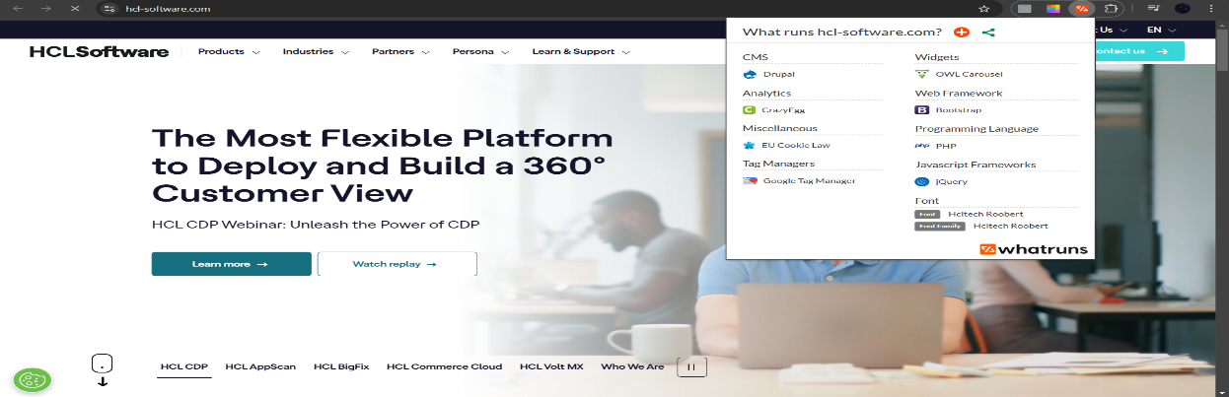
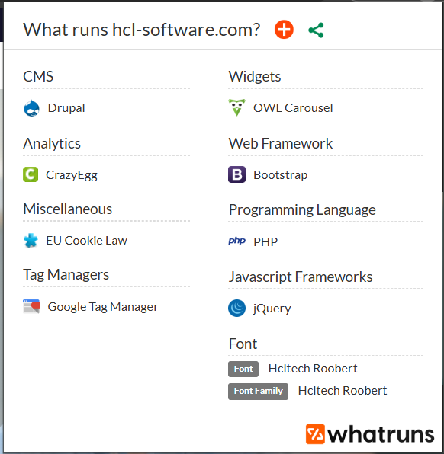
Website platform identification
The HCL Tech Website(https://www.hcl-software.com/) Is Developed On Drupal.
Drupal Is An Open-source Content Management System (CMS) Which Used By HCL Technologies For Building And Managing Websites And Digital Platforms. HCL Leverages Drupal For Various Enterprise-level Solutions, Focusing On Digital Transformation And Experience Management.
Tool Used: WhatRuns.

Slide 8

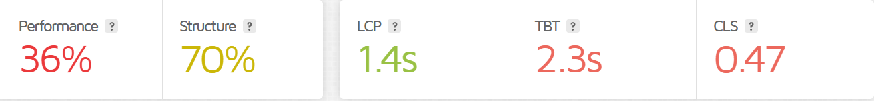
Responsive Design Testing
Tools Used are,
Google Pagespeed Insights
Gtmetrix
Tested Pages For HCL Company:
Contact Us Page(https://Www.Hcl-software.Com/): In This Page, The LCP(Largest Contentful Paint) Measures How Long It Takes For The Largest "Content Element" (E.G., Hero Image, Heading Text, Etc.) on our Page To Become Visible Within the Visitor's Viewpoint. For Good Experience The Lcp Should Be 1.2sec Or Less.
TBT(Total Blocking Time ) Tells You How Much Time Is Blocked By Scripts During our Page Loading Process. For A Good User Experience, Aim For A TBT Of 150 Milliseconds Or Less.
CLS(Cumulative Layout Shift) Indicates How Much Layout Shift(visual Stability Of A Page Load) Is Experienced By Visitors As our Page Loads. For A Good User Experience, Aim For A CLS Score Of 0.1 Or Less.
Hence, This Page Is Not Well Optimized In Mobile As Well As Desktop

Slide 9
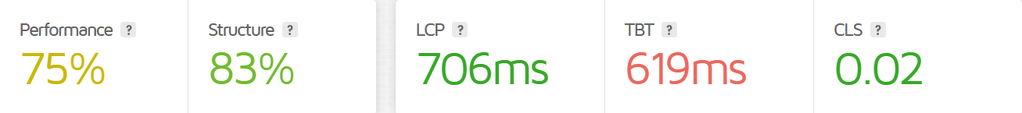
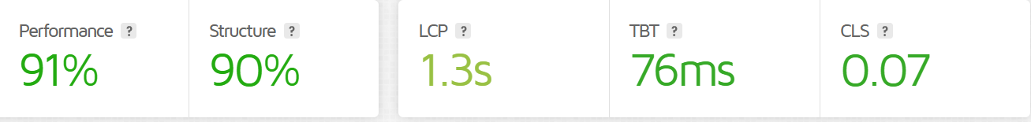
Responsive Design Testing
Product Page(https://www.hcl-software.com/products?referrer=www.hcl-software.com): In This Page, The Lcp(largest Contentful Paint) is 706ms, for Good Experience The Lcp Should Be 1.2sec Or Less.
TBT(Total Blocking Time ) for this page is 619ms. For A Good User Experience, should Aim For A TBT Of 150 Milliseconds Or Less.
CLS(Cumulative Layout Shift) for this page is 0.02. For A Good User Experience, Aim For A CLS Score Of 0.1 Or Less.
Hence, This Page Is partially optimized In Mobile As Well As Desktop and needs improvement.
Career Page(https://support.hcl-software.com/csm?referrer=www.hcl-software.com): In This Page, The Lcp(largest Contentful Paint) is 1.3s, for Good Experience The Lcp Should Be 1.2sec Or Less.
TBT(Total Blocking Time ) for this page is 76ms. For A Good User Experience, should Aim For A TBT Of 150 Milliseconds Or Less.
CLS(Cumulative Layout Shift) for this page is 0.07. For A Good User Experience, Aim For A CLS Score Of 0.1 Or Less.
Hence, This Page Is well optimized In Mobile As Well As Desktop.

Slide 10
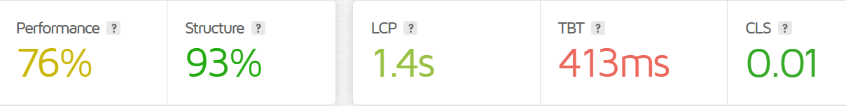
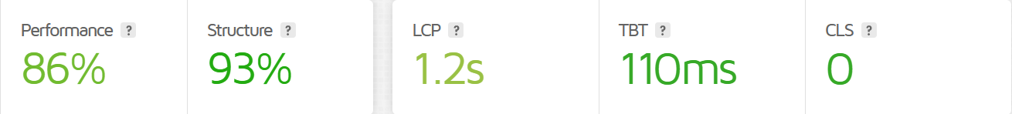
Responsive Design Testing
Home Page(https://www.hcltech.com/): In This Page, The Lcp(largest Contentful Paint) is 1.4s, for Good Experience The Lcp Should Be 1.2sec Or Less.
TBT(Total Blocking Time ) for this page is 413ms. For A Good User Experience, should Aim For A TBT Of 150 Milliseconds Or Less.
CLS(Cumulative Layout Shift) for this page is 0.01. For A Good User Experience, Aim For A CLS Score Of 0.1 Or Less.
Hence, This Page Is partially optimized In Mobile As Well As Desktop and needs improvement.
Career Page(https://www.hcltech.com/careers): In This Page, The Lcp(largest Contentful Paint) is 1.2s, for Good Experience The Lcp Should Be 1.2sec Or Less.
TBT(Total Blocking Time ) for this page is 110ms. For A Good User Experience, should Aim For A TBT Of 150 Milliseconds Or Less.
CLS(Cumulative Layout Shift) for this page is 0. For A Good User Experience, Aim For A CLS Score Of 0.1 Or Less.
Hence, This Page Is well optimized In Mobile As Well As Desktop.

Slide 11
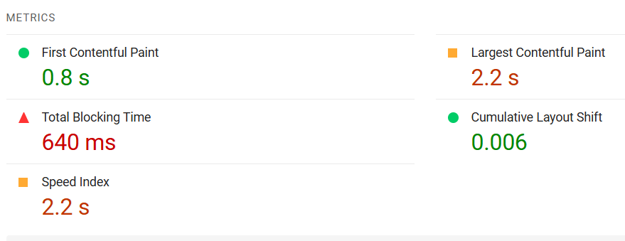
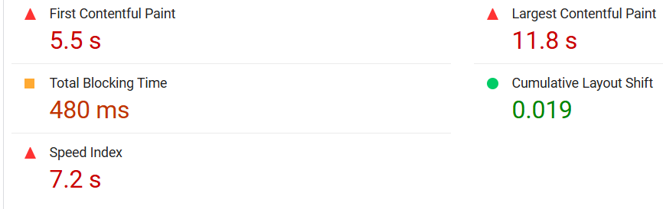
Website Mistakes Identification
Website Mistakes Identification(https://www.hcltech.com/). Tools Used are - Google Pagespeed Insights
The Loading Time Of This Page In Desktop Took 2.2sec Which Is Below 5sec. Hence, The Page Is Well Optimized, The Loading Time Of This Page In Mobile Took 7.2sec Which Is Above 5sec. Hence, The Page Is Not Well Optimized
Largest Contentful Paint Element 11,780 Ms.
Reduce The Impact Of Third-party Code Third-party Code Blocked The Main Thread For 310 Ms
Reduce Unused CSS(Cascading Style Sheets) Potential Savings Of 156 Kb
Avoid An Excessive Date Elements Size - A Large DOM Will Increase Memory Usage, Cause Longer Style Calculations.
Initial Server Response Time Was Short

Slide 12
Best Practices List
Best Practices For Creating Visually Appealing And User-friendly Website Designs
Place A Clear Call To Action (CTA): What Do You Want Visitors To Do On Your Website? Whether It's Signing Up For A Newsletter, Making A Purchase, Or Contacting You, Make It Clear What You Want Them To Do And How To Do It.
Links Should Have Descriptive Text :Here Couple Of Links(https://www.hcltech.com/press-releases/hcltech-completes-acquisition-communications-technology-group-assets-hewlett-packard ) Doesn't Have Description, Descriptive Link Text Helps Search Engines Understand Your Content.
Design And Layout: Ensure The Website Is Mobile-friendly And Adapts Seamlessly To Different Screen Sizes And Devices. Here while browsing the web page error occurs which can be optimized
Navigation: Keep Navigation Intuitive With Clearly Labeled Menu Items And Dropdowns For Subcategories.
Performance: Optimize Images and Minimize Css/Javascript To Reduce Page Load Times.
Seo Integration: Create Clean, Descriptive Urls That Are Easy To Read. Add Relevant Meta Titles And Descriptions To Every Page. Use Structured Data To Enhance Search Engine Visibility And Display Rich Snippets. Link To Relevant Internal Pages To Improve Navigation And SEO.
Security: Ensure The Site Is Secure With HTTPS(SSL Certification). Updating Scripts Updated To Prevent Vulnerabilities. Include A Clear Privacy Policy To Inform Users About Data Handling Practices.
Testing And Optimization: Conduct Tests With Real Users To Identify Pain Points And Improve Design. Use Tools Like Google Analytics To Track User Behavior And Make Data-driven Decisions.

Slide 13
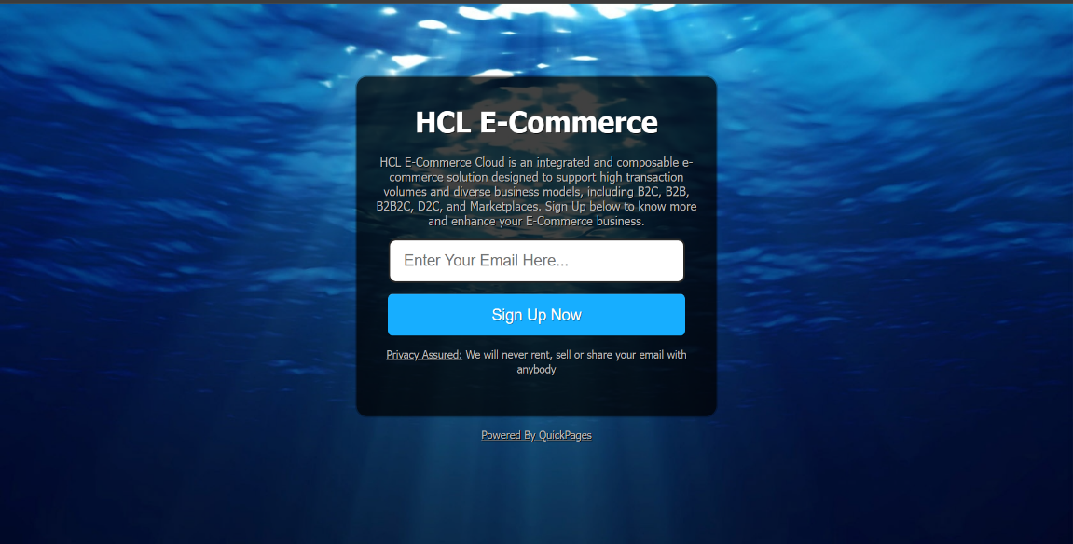
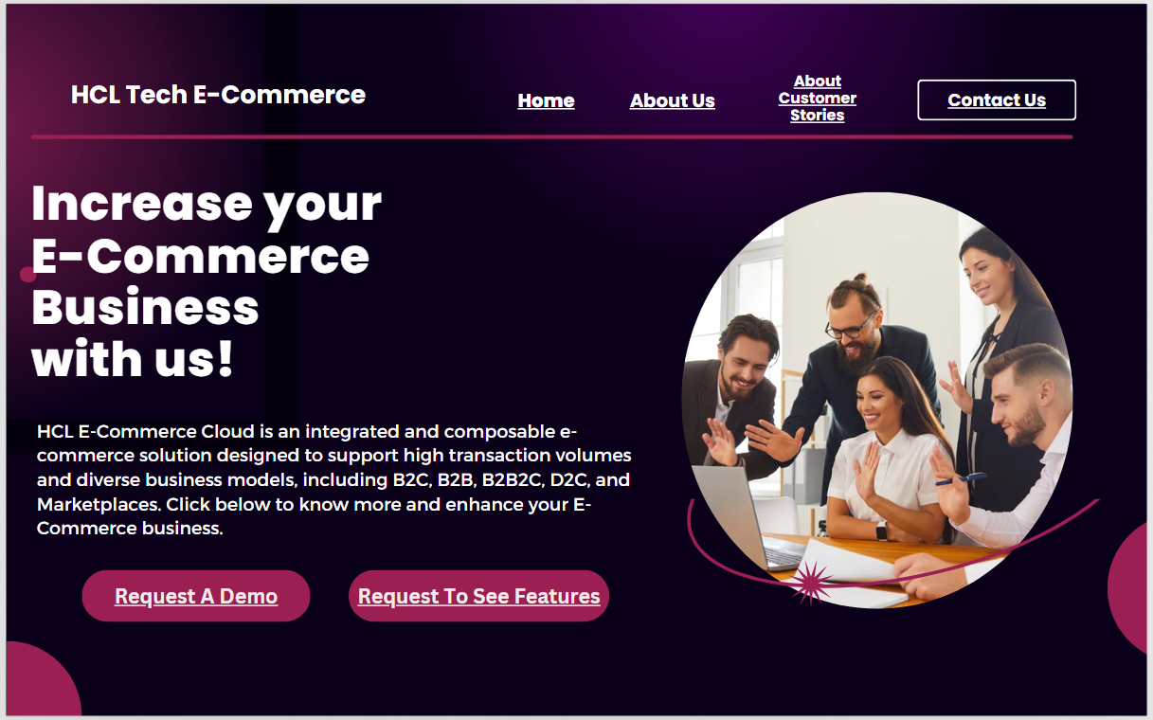
Landing Page
Landing Page 1 - https://qkpage1.co/p/HCL_E-Commerce_Cloud (Tool Used - Quickpage)
Landing Page 2 - https://www.canva.com/design/DAGahPpkyH4/sDVKAT_pON7DDUk-ku5iGQ/view?mode=prototype (Tool Used - Canva)
HCL E-Commerce page - https://www.hcl-software.com/commerce?referrer=www.hcl-software.com

Slide 14

Conclusion
This Project Has Successfully Demonstrated The Essential Aspects Of Digital Marketing And Website Design, Focusing On Creating A Compelling And User-friendly Online Presence For HCL Tech.
By Understanding The Fundamentals Of Digital Marketing, Identifying Key Design Principles, And Applying Best Practices.
I Have Crafted A Landing Page That Effectively Showcases Hcl E-commerce Business, Aiming To Generate Leads And Enhance Brand Awareness.
The Actionable Insights And Design Recommendations Provided Will Contribute To The Continuous Improvement And Optimization Of Hcl Tech. Digital Presence.

Slide 15
Thank You!

